Slide 1
“Video Conferencing”
Task - 1

Slide 2

VIDEO CONFERENCING
*Video conferencing is a type of online meeting where two or more people talk through a vedio and audio call in real-time
LMS Username | Name | Batch
2129a42166 | NIHIL KUMAR S | A42
2129a42167 | NIRMAL KUMAR G | A42
2129a42168 | NISHARANI S | A42
2129a42169 | PAVITHRA K | A42

Slide 3
SRS for “Video Conferencing"
Functional Requirements
High resolution webcam
Fast computer processing
Sufficient network bandwidth
Video display screen
Microphone
video conferencing system

Slide 4
SRS for “Video Conferencing"
Non Functional Requirements
Performance
Scalability
Portability
Security
Usability

Slide 5
SRS for “Video Conferencing"
Software Requirements
Desktop End-Point software
Broadband Internet Access
Mobile Apps
Web conference Software

Slide 6
SRS for “Video Conferencing
Hardware Requirements
Camera
Codec Unit
Video Display
Microphone
Speakers

Slide 7
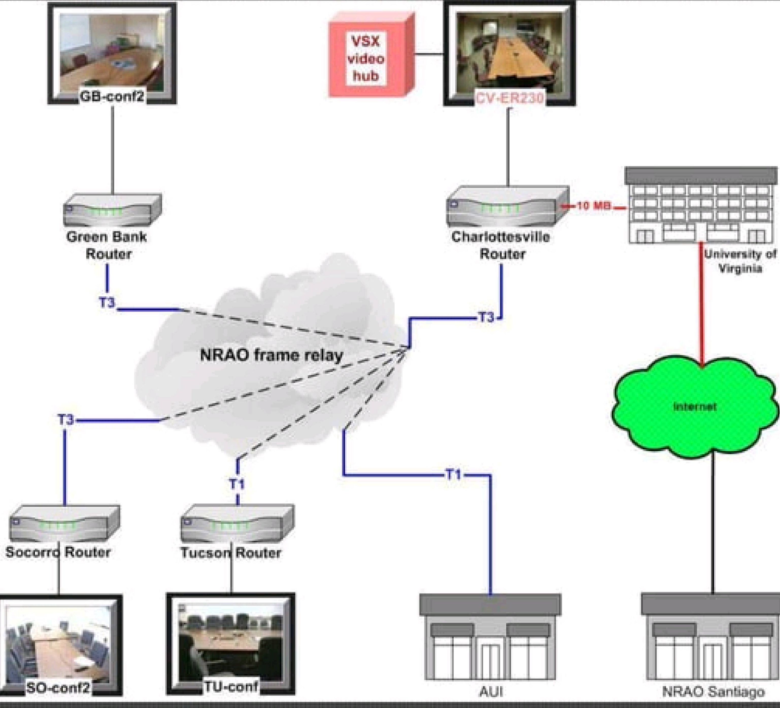
Process of Video Conferencing
Gather requirements for the project
add Readme.md file with description of the project
Prepare database design schemas
Check-List
Commit all changes with "first commit"
Get your initial project Structure ready
create a repository on github realted to project
Initiate a git repository
Push your changes to github

Slide 8
Submission Github
https://github.com/Nisha2129/video-conferencing--2129a42168/new/main?readme=1

